Slide 1
CSS FLEXBOX
HASAN
.+ Cinta = Keikhlasan +.

Slide 2

Flexbox merupakan sebuah metode
tata letak satu dimensi untuk
meletakkan suatu item
dalam suatu baris
atau kolom.
What is Flexbox?

Slide 3

Why Flexbox?
Support all Browser
Item Alignment
Responsive Web

Slide 4

How to use?
<html>
<head>
<meta charset=“utf-8”>
<title>Flex</title>
<style>
.flex{ display: flex;}
.flex > div{
padding:10px;
background-color:#cd3;
margin:3px;
}
</style>
</head>
<body>
<div class=“flex”>
<div>item 1</div>
<div>item 2</div>
<div>item 3</div>
</div>
</body>
</html>
hasil

Slide 5

Without flex?
<html>
<head>
<meta charset=“utf-8”>
<title>Flex</title>
<style>
.blok{ display: block;}
.blok > div{
padding:10px;
background-color:#cd3;
margin:3px;
}
</style>
</head>
<body>
<div class=“blok”>
<div>item 1</div>
<div>item 2</div>
<div>item 3</div>
</div>
</body>
</html>
Block
Inline
Table

Slide 6
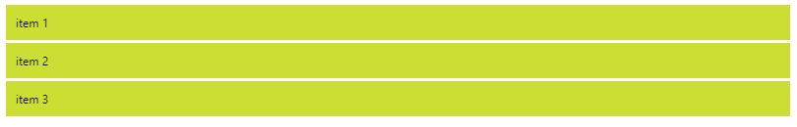
Hasil tanpa Flex

Slide 7
Flex
Parent
Direction
Wrap
Child
Order
Flow
Justify Content
Align Items
Align Content
Grow
Shrink
Basis
Flex
Align Self
Column
Column-reverse
Row
Row-reverse
Wrap
No-wrap
Wrap-reverse
Direction
Wrap
Space-between
Space-around
-start
-end
center

Slide 8





Time to code!

Slide 9


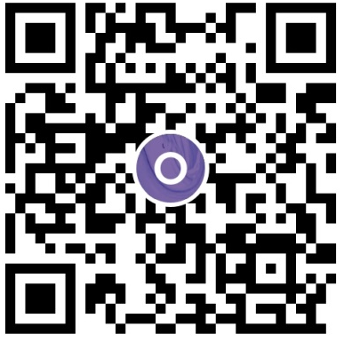

Buy me a coffee?

Slide 10
Thank you!

